Slide 1
Network Security Project 1 NFC Ticket App Demo
Group 36: YANG Je-Ruei, XU Zehui

Slide 2
Overview
Ticket Data Structure
Issuing New Ticket
Using Ticket

Slide 3
Ticket Data Structure (Last Week)
Issues:
1. Unnecessary 2-block backup implementation in our initial design.
2. Both issue and use use the same writing strategy, resulting in unnecessary page writing.
3. HMAC still uses too many pages.
4. Only use expire time to check if it’s the first use, it will suffer from rollback attacks.
Page | Byte number
 | 0 | 1 | 2 | 3
4 | upper bound
5 | expiration time
6 | HMAC
7
8 | upper bound
9 | expiration time
10 | HMAC
11
41 | counter page

Slide 4
Ticket Data Structure
Changes:
1. Remove 2-block backup implementation.
2. Distinguish the pages used by issue and use to ensure that only necessary pages are written.
3. Reduce HMAC to 1 page.
4. Record the init counter, and when it seems to be the first use, we check whether there is a rollback.
Page | Byte number
 | 0 | 1 | 2 | 3
4 | max counter
5 | init counter
6 | expiration time
7 | HMAC
41 | counter page
42 | auth0
43 | auth1

Slide 5
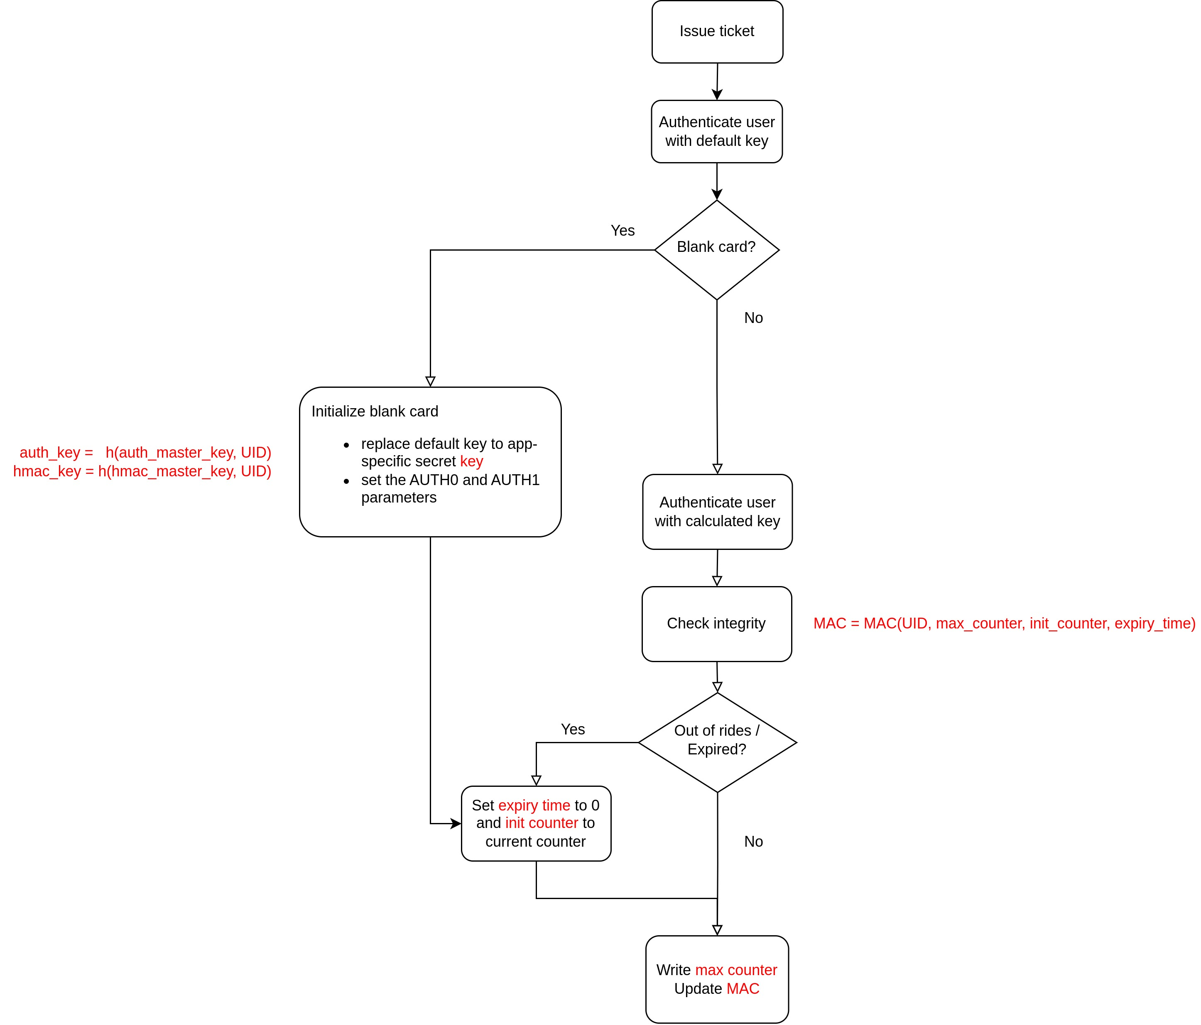
Issuing New Ticket

Slide 6
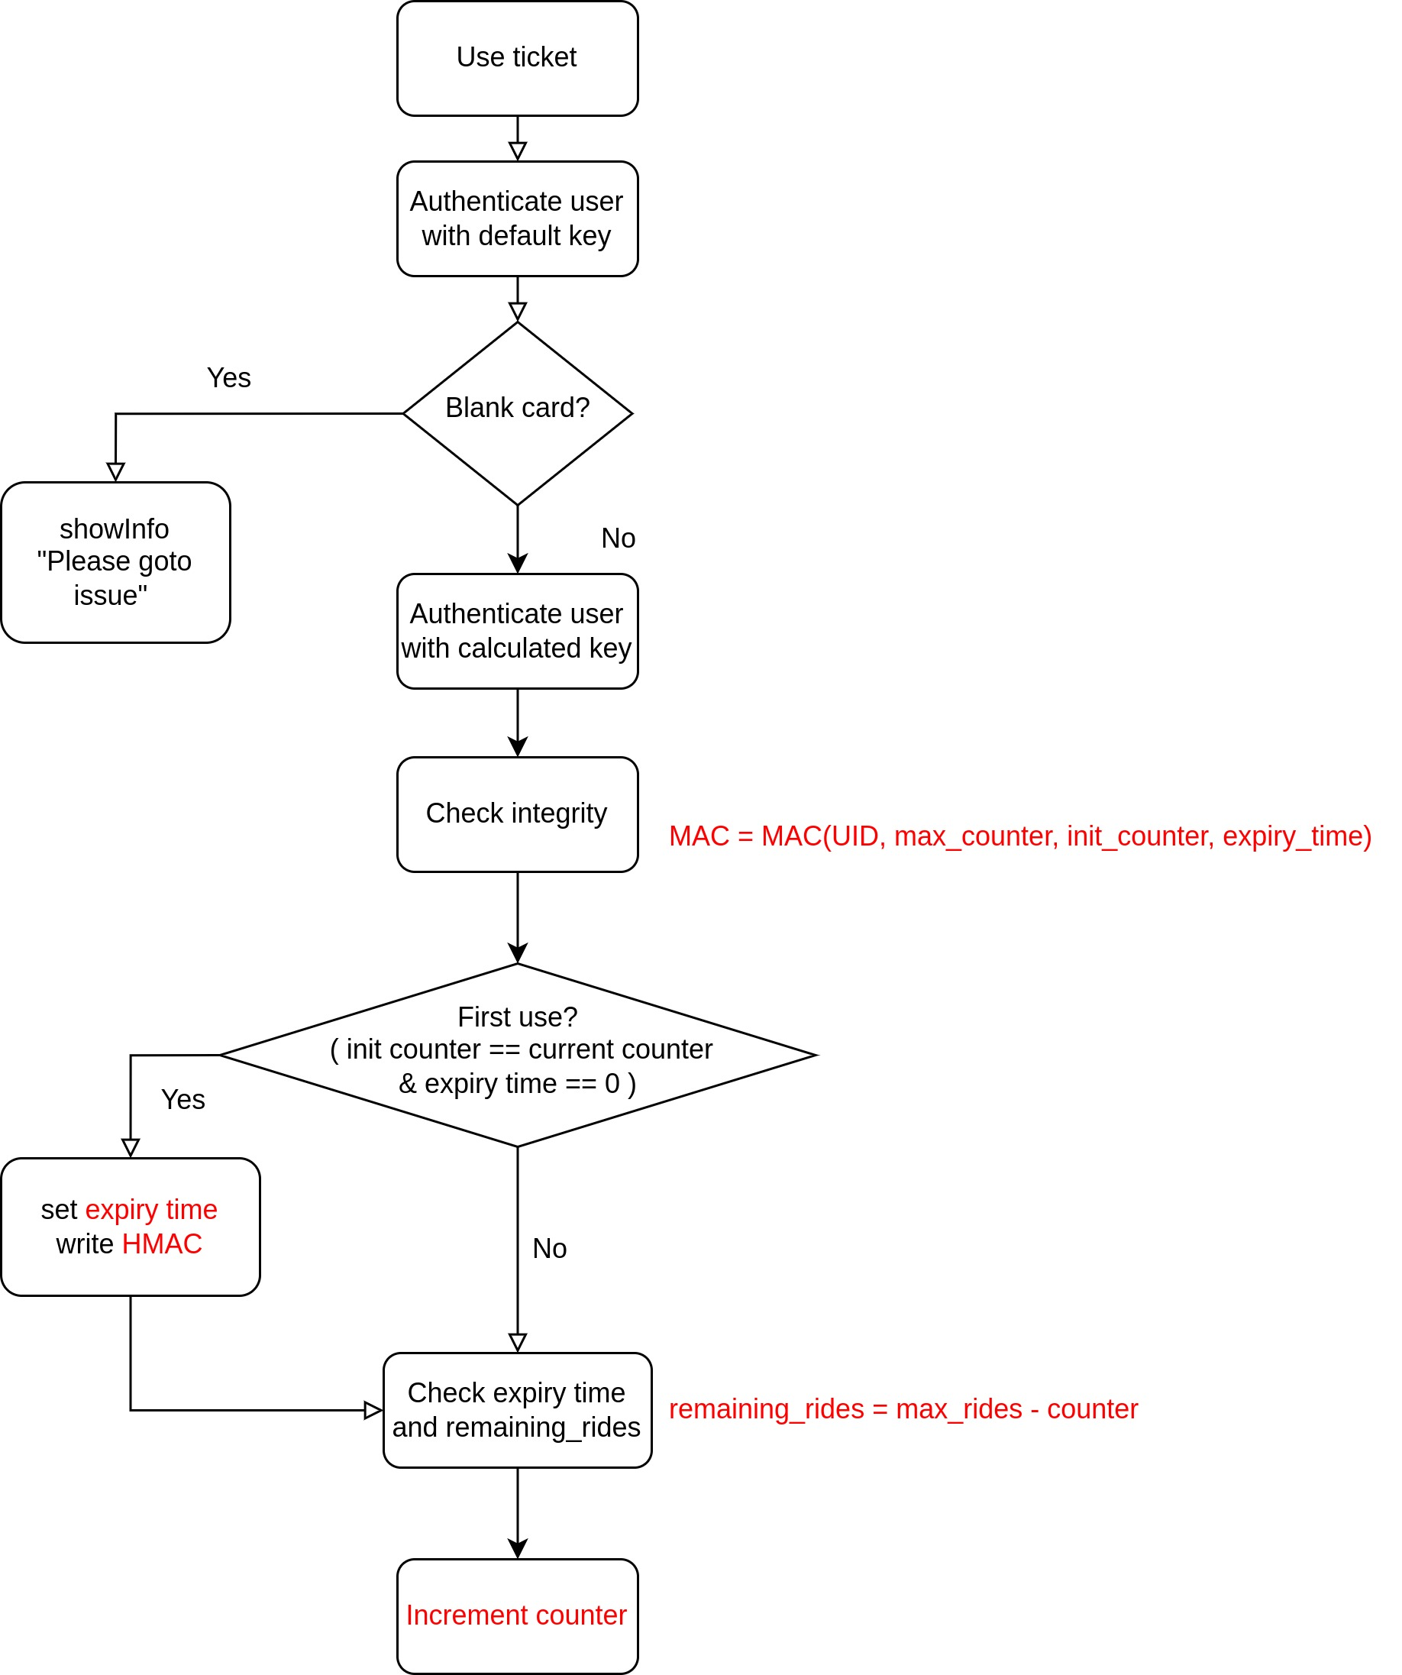
Using Ticket

Slide 7
Rollback attack Assume an attacker tries to rollback a used card’s expire time to 0 and use expired rides. The counter must have been incremented in the past. In this case, the current counter does not equal the initial counter, an error will be triggered.
MITM attack MITM can only be adopted on the same card since both the authKey and the hmacKey are specific to UID.
Modifications:
The integrity of data is ensured via HMAC, modifications will break the card's integrity.
Replay Attacks:
Won't work as we write the final state rather than incremental values.

Slide 8

Demo

